Slide 1
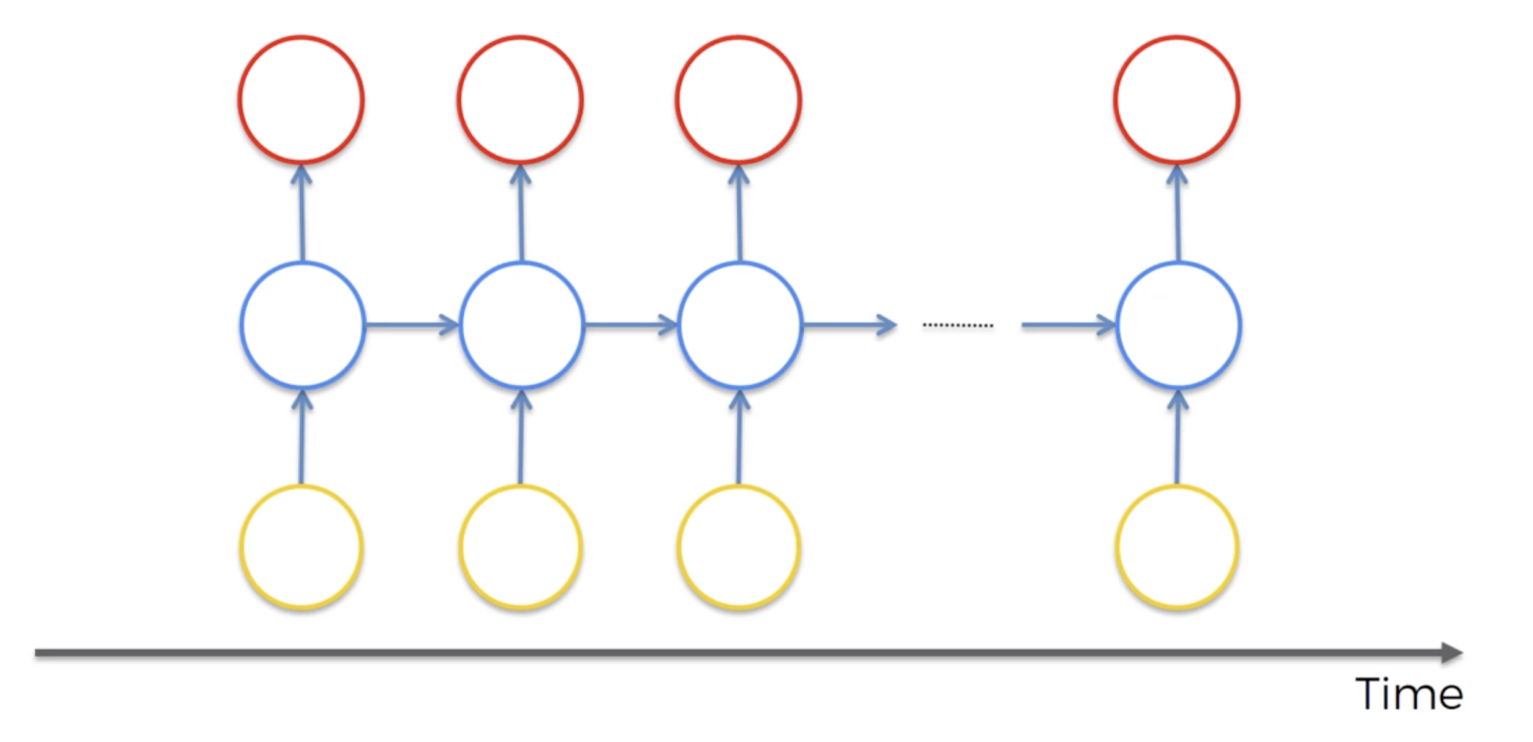
SIMPLIFIED STRUCTURE OF AN RNN ILLUSTRATED WITH A TRANSLATION EXAMPLE
OUTPUTS
Shakira
es
genial
<END>
NEURONS
The same network receiving its own output from the previous step
INPUT SEQUENCE
Shakira
is
great
<END>

Slide 2
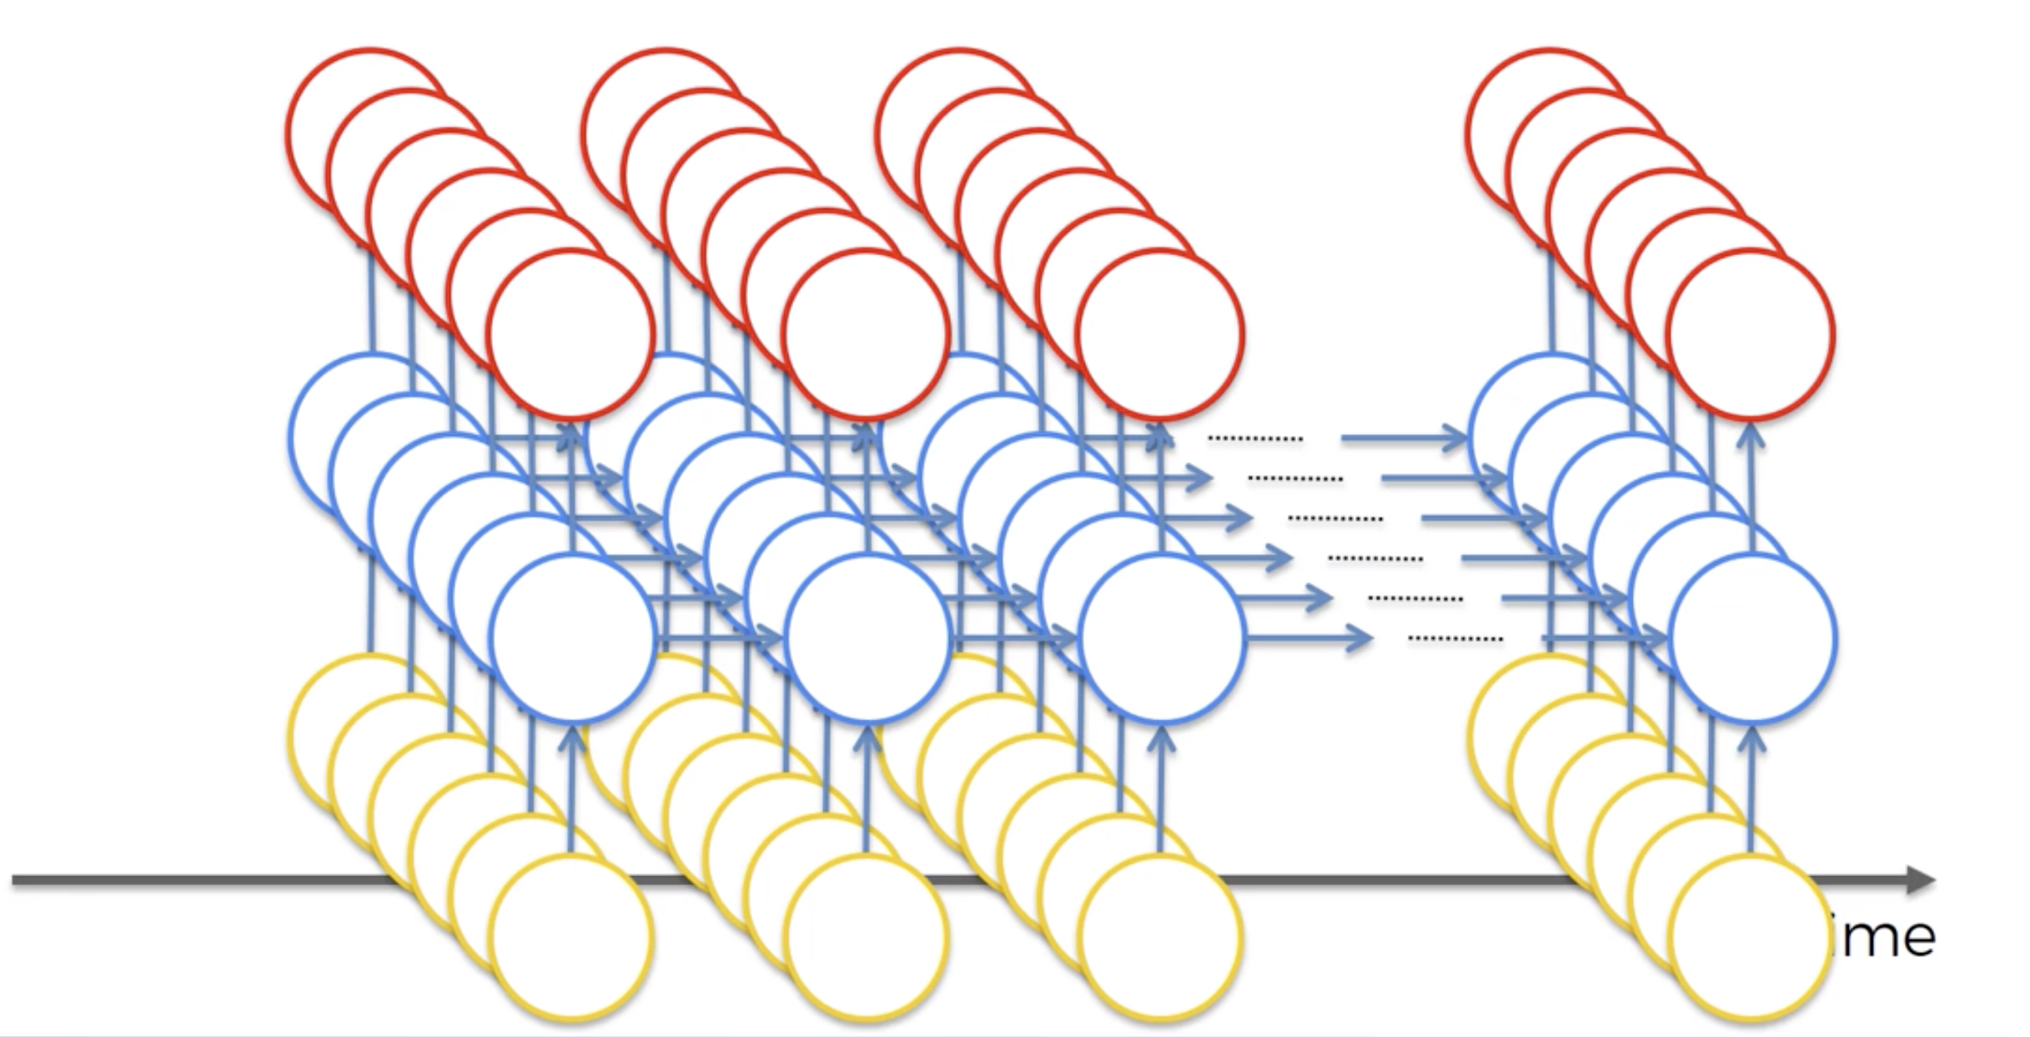
RNNs can be multiple layers deep, taking multi-dimensional input
Shakira
es
genial
Named entity tags
/B-PER
/O
/O
Part of speech tags
Noun
Verb
Adj
Words
Shakira
is
great

Slide 3
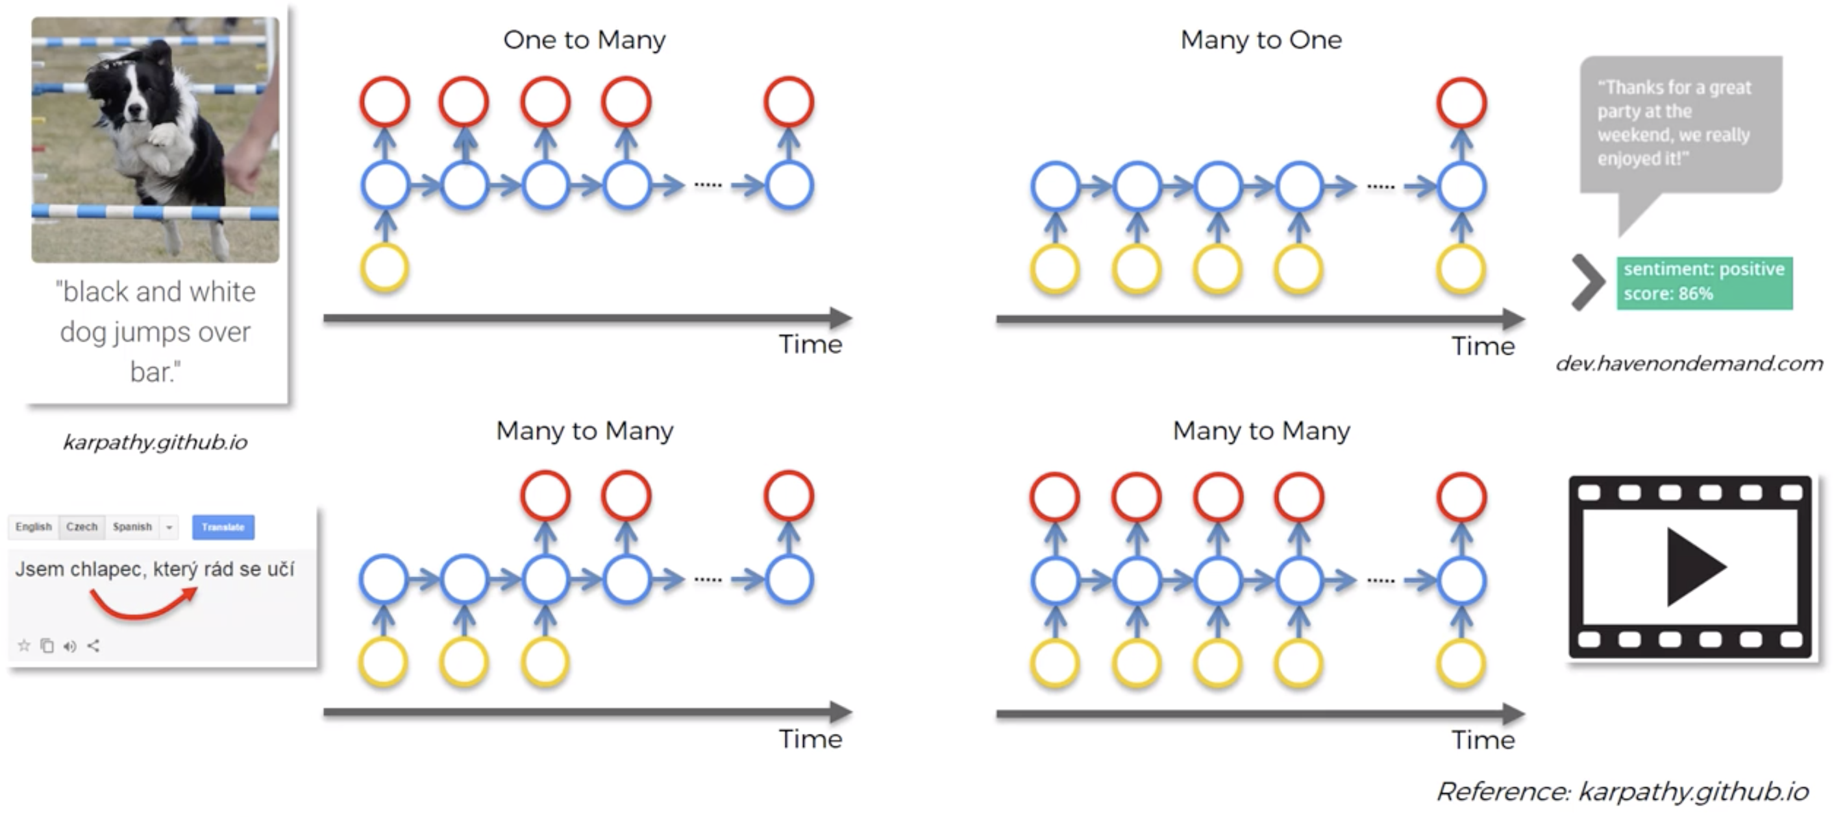
Describing an image
Sentiment Analysis
One output (the sentiment score)
One input (the image)
Translation
Description of video

Slide 4
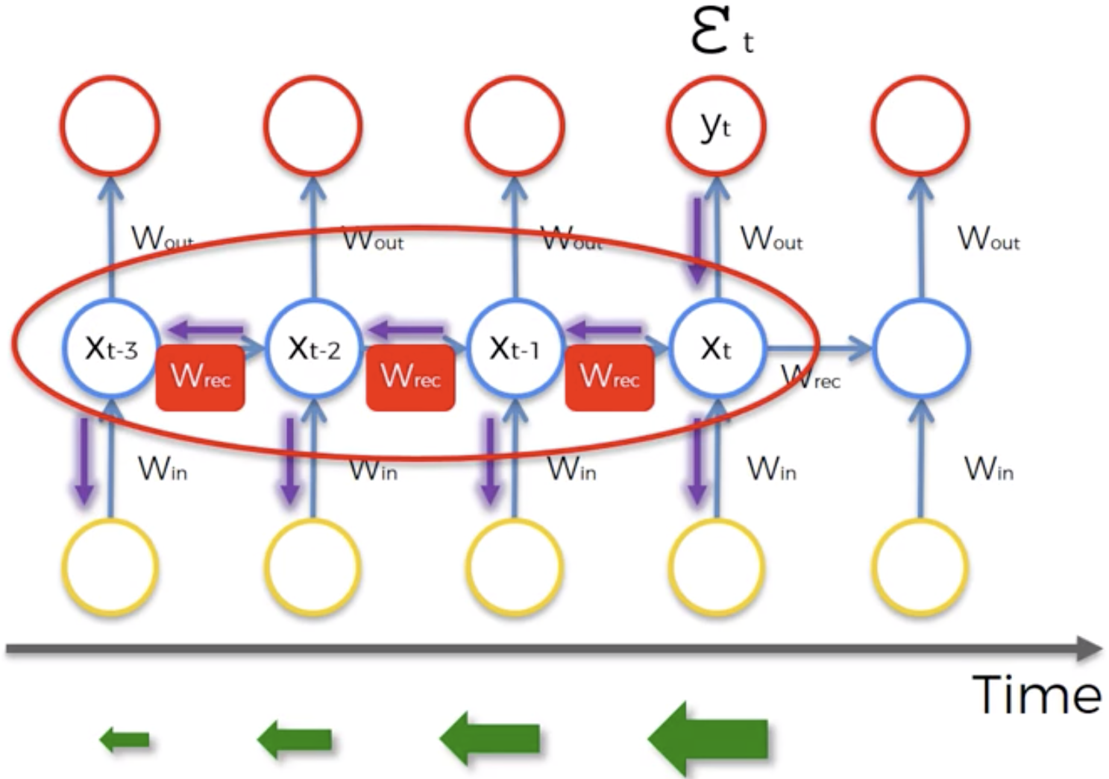
Illustration of the Vanishing Gradient Problem in an RNN
Recurrent Neurons
Input Neurons
Gradient
The gradient caused by the error at step “t” is very small when we need
to update the weights of ”t-3”.

